Slide 1
Encoding
Encoding is technique convert things into some form of code
ML algorithm require all input variables and output variables to be numeric.so, we need to encode the categorical data columns before applying Ml algorithm.

Slide 2
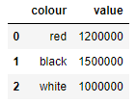
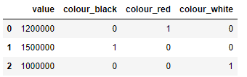
Nominal encoding
There are two types of categorical variable, nominal and ordinal. A nominal variable has no intrinsic ordering to its categories. For example colors of car red,white and black.
One hot encoding: Encoding each categorical variable with different Boolean variables (also called dummy variables) which take values 0 or 1, indicating if a category is present in an observation.
One hot encoding

Slide 3
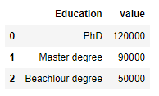
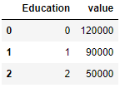
Ordinal encoding
If the relationship between any categorical column as independent variable and dependent variable (Target Variable) is important, then we need to apply ordinal encoding for example person salary which has relation with education.
Label Encoding : here unique number will be provided to each categories in categorical column.
Lable encoding

